Slide 1
PERSONAL VIRTUAL ASSISTANT:
JARVIS USING PYTHON
Jarvis: “Just A Rather very intelligent system

Slide 2

By
HOLE VIDISH PANDURANG Roll No: 104016
CHAVAN JAYDEEP VIJAY Roll No: 104017
TODKARI SHIVAM VARDHASHANKAR Roll No: 104018
PARDESHI GAYATRI RAJENDRA Roll No: 104019
HARKE ATHARWA SANJAY Roll No: 104020
NINGDALI ABHISHEK HANUMANT Roll No: 104021
PAWAR GANESH AVACHIT Roll No: 104022
Under the supervision of
Prof. A.V. Gunjal
First Year Engineering Department
SINHGAD COLLEGE OF ENGINEERING

Slide 3
OUTLINE
INTRODUCTION
SOFTWARE DETAILS AND RESOURCES
HOW IT WORKS?
METHODOLOGY
LIMITATIONS
FUTURE SCOPE AND ENHANCEMENT OF THE PROJECT
REFRENCES

Slide 4
INTRODUCTION
What is virtual assistant?
A virtual assistant, also called AI assistant or digital assistant, is an application program thar understand natural language voice commands and completes tasks for the user.
The project aims to develop a personal virtual assistant. This project draws its inspiration from virtual assistant like Cortana, Siri and Google assistant. In this project we use Python language. As we know Python is an emerging language so it becomes easy to write a script for Virtual Assistant in Python. The instructions for the assistant can be handled as per the requirement of user. Speech recognition is the Alexa Siri, etc.

Slide 5
In Python there is an API called Speech Recognition which allows us to convert speech into text. It was an interesting task to make my own assistant. Searching on Google without opening the browser, and performing many other daily tasks like playing music, opening your favorite website with the help of a single voice command. In the current scenario, advancement in technologies are such that they can perform any task with same effectiveness or can say more effectively than us. By making this project. I realized that the concept of Al in every field in decreasing human effort and saving time.

Slide 6
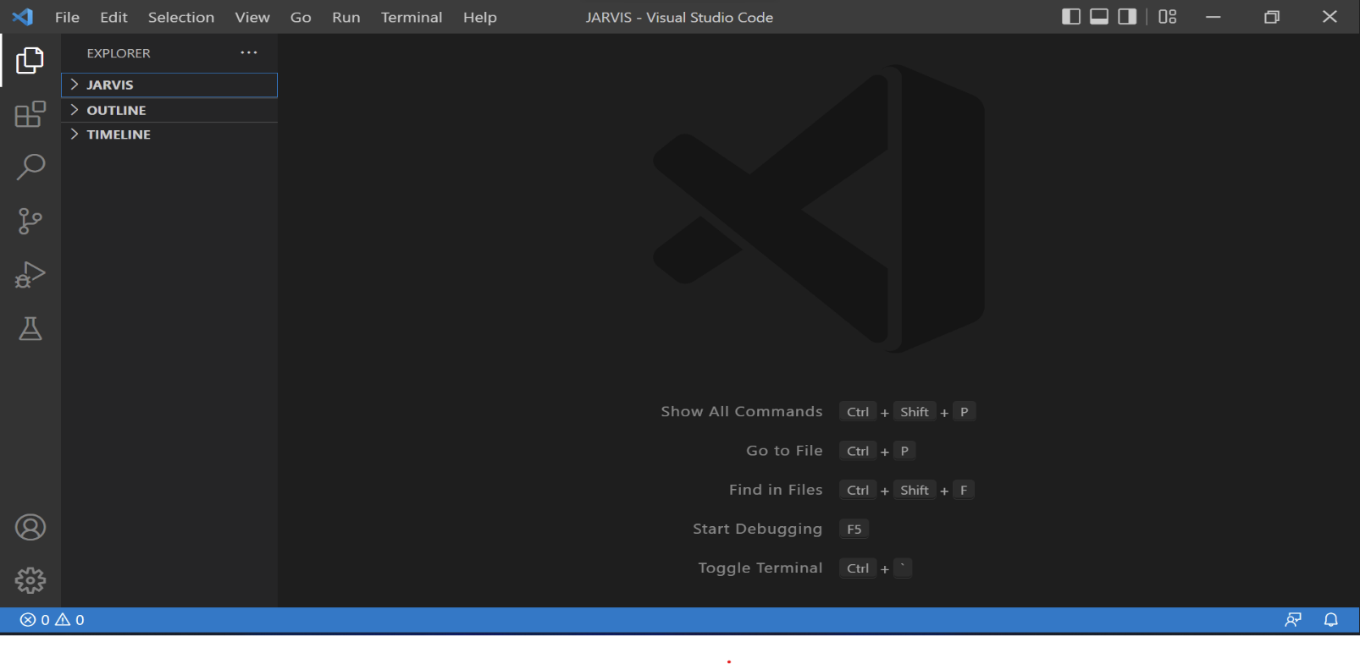
SOFTWARE DETAILS AND RESOURCES
VIRTUAL STUDIO CODE
Visual studio code is a lightweight but powerful source code editor which runs on your desktop made by MICROSOFT and is available for windows, macOS and Linux

Slide 7
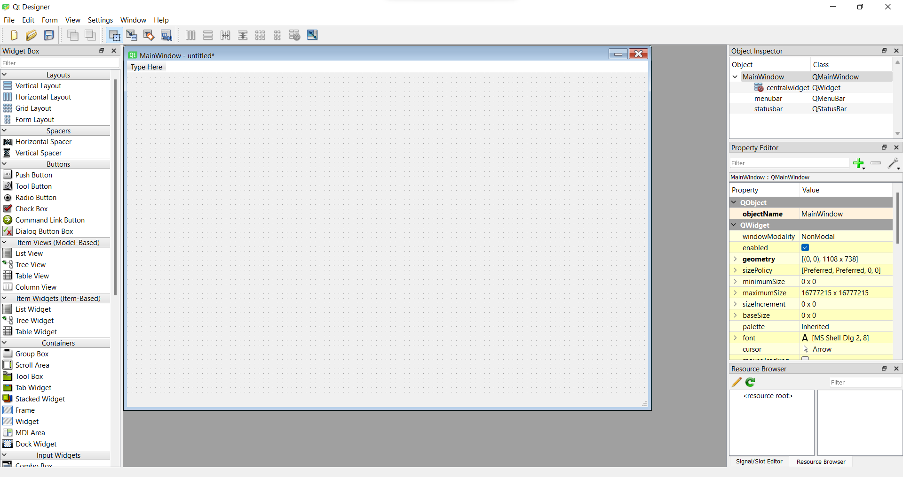
QT DESIGNER
Qt Designer is a tool for quickly building graphical user interfaces with widgets from the Qt GUI framework. It gives you a simple drag-and-drop interface for laying out components such as buttons, text fields, combo boxes and more.

Slide 8
PROGRAMMING LANGUAGE: PYTHON
Python is an interpreted, object-oriented, high-level programming language with dynamic semantics. Its high-level built in data structures, combined with dynamic typing and dynamic binding, make it very attractive for Rapid Application Development, as well as for use as a scripting or glue language to connect existing components together. Python's simple, easy to learn syntax emphasizes readability and therefore reduces the cost of program maintenance

Slide 9
HOW IT WORKS?
Provide an accurate command (for e.g. open YouTube)
Jarvis record that voice and match with available commands
If it is available then proper response is provided.
If input related command is not present in task then it will search that task in super intelligent function (wolfram alpha) or Google.
It will keeps on asking for the commands from the user until the user say "goodbye, bye, exit, stop, offline"

Slide 10
METHODOLOGY
START
GUI for interaction will appear on screen
After clicking on START it will start working
INPUT
It will take input through voice commands
It will find the task related to the input and try to give output
If input related input is not present in task then it will search that task in super intelligent function (wolframalpha)
EXIT
It will keeps on asking for the commands from user until the users say "Goodbye ,Bye, Exit, Stop, Offline"

Slide 11
LIMITATIONS
Background voice can interfere
Misinterpretation because of accents and may cause inaccurate result
JARVIS cannot be called externally anytime like other traditional assistants like Google Assistant can be called just by saying. "Ok Google

Slide 12
FUTURE SCOPE AND THE ENHANCEMENT OF THE PROJECT
The virtual assistants which are currently available are fast and responsive but we still have to go a long way. The understanding and reliability of the current Jarvis is need to be improved a lot. The Jarvis available nowadays are still not reliable in critical scenarios. The future of these assistant will have the virtual assistants incorporated with Artificial Intelligence which includes Machine Learning, Neural Networks, etc. and lots of things.

Slide 13
REFERENCES
WEBSITES:
www.stackoverflow.com
www.python.org
www.geeksforgeeks.comwww.github.com
www.walframalpha.comwww.google.co.in
www.pythonprogramming.net
YOUTUBE CHANNELS:
Codewithharry
Avi Upadhyay

Slide 14
THANK YOU!!!

